Slide 1
4. Trees
Part 2

Slide 2
Objectives
2
Balanced Binary Tree Definitions
Balancing a Tree - Simple Balanced Algorithm
Rotations on Binary Search Tree
AVL Tree
Insertion in an AVL Tree
Deletion in an AVL Tree
Heaps
Heaps as Priority Queue
Polish Notation and Expression Trees
Notes:
2

Slide 3
Balanced Binary Tree Definitions
A binary tree is height-balanced if for every internal node p of T, the heights of the children of p differ by at most 1.
A tree is considered perfectly balanced if it is height-balanced and all leaves are to be found on one level or two levels.
What is a balanced tree in general?
There are several ways to define "Balanced". The main goal is to keep the depths of all nodes to be O(log(n)).

Slide 4
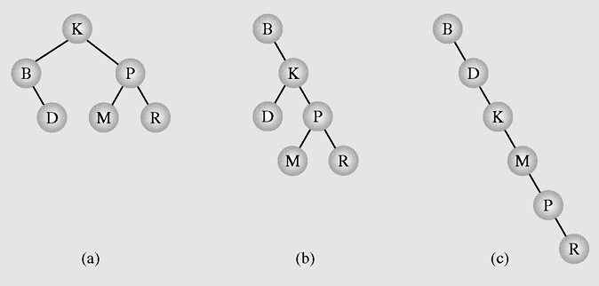
Why need to balance a Binary Search Tree?
4
Different binary search trees with the same information

Slide 5
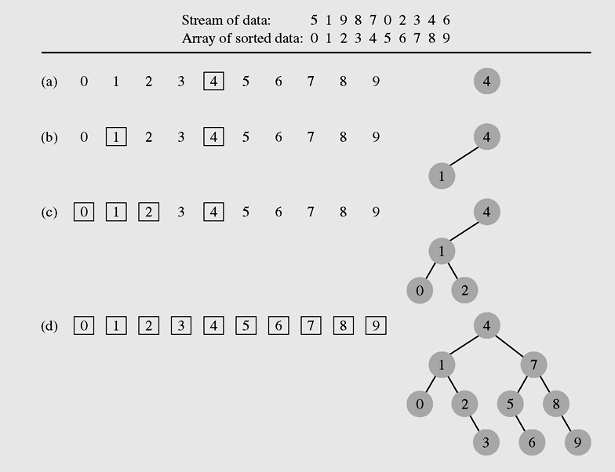
Balancing a Tree - Simple Balance Algorithm - 1
5
Balancing a tree:
Copy all tree nodes to an array
Sort the array
Clear the tree
Call balance() method to rebuild the tree
Creating a binary search tree from an ordered array

Slide 6
Balancing a Tree - Simple Balance Algorithm - 2
6
public void balance(T data[], int first, int last) {
if (first <= last) {
int middle = (first + last)/2;
insert(data[middle]);
balance(data,first,middle-1);
balance(data,middle+1,last);
}
}
public void balance(T data[]) {
balance(data,0,data.length-1);
}
Notes:
Do it in Eclipse
6

Slide 7
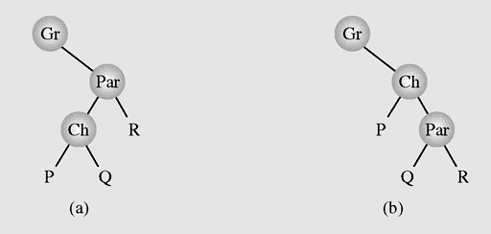
Right Rotation
Rotations on Binary Search Tree
7
rotateRight: rotate the node Par to right about its left child Ch
Ch become new root of the subtree
Right subtree of Ch becomes left subtree of Par
Par subtree becomes right subtree of Ch
Right rotation
Left rotation
Right rotation of Par about its' left child Ch
Notes:
package weiss.nonstandard;
class Rotations
{
/**
* Rotate binary tree node with left child.
* For AVL trees, this is a single rotation for case 1.
*/
static BinaryNode rotateWithLeftChild( BinaryNode k2 )
{
BinaryNode k1 = k2.left;
k2.left = k1.right;
k1.right = k2;
return k1;
}
/**
* Rotate binary tree node with right child.
* For AVL trees, this is a single rotation for case 4.
*/
static BinaryNode rotateWithRightChild( BinaryNode k1 )
{
BinaryNode k2 = k1.right;
k1.right = k2.left;
k2.left = k1;
return k2;
}
/**
* Double rotate binary tree node: first left child
* with its right child; then node k3 with new left child.
* For AVL trees, this is a double rotation for case 2.
*/
static BinaryNode doubleRotateWithLeftChild( BinaryNode k3 )
{
k3.left = rotateWithRightChild( k3.left );
return rotateWithLeftChild( k3 );
}
/**
* Double rotate binary tree node: first right child
* with its left child; then node k1 with new right child.
* For AVL trees, this is a double rotation for case 3.
*/
static BinaryNode doubleRotateWithRightChild( BinaryNode k1 )
{
k1.right = rotateWithLeftChild( k1.right );
return rotateWithRightChild( k1 );
}
}
7

Slide 8
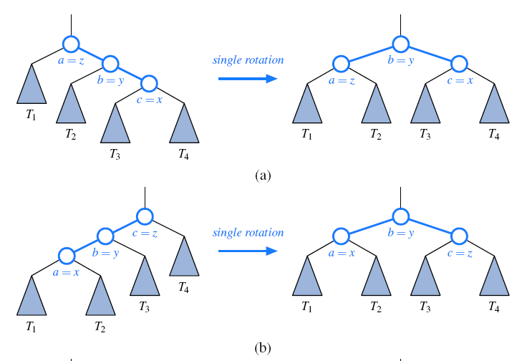
Rotations on Binary Search Tree demo - 1
Notes:
package weiss.nonstandard;
class Rotations
{
/**
* Rotate binary tree node with left child.
* For AVL trees, this is a single rotation for case 1.
*/
static BinaryNode rotateWithLeftChild( BinaryNode k2 )
{
BinaryNode k1 = k2.left;
k2.left = k1.right;
k1.right = k2;
return k1;
}
/**
* Rotate binary tree node with right child.
* For AVL trees, this is a single rotation for case 4.
*/
static BinaryNode rotateWithRightChild( BinaryNode k1 )
{
BinaryNode k2 = k1.right;
k1.right = k2.left;
k2.left = k1;
return k2;
}
/**
* Double rotate binary tree node: first left child
* with its right child; then node k3 with new left child.
* For AVL trees, this is a double rotation for case 2.
*/
static BinaryNode doubleRotateWithLeftChild( BinaryNode k3 )
{
k3.left = rotateWithRightChild( k3.left );
return rotateWithLeftChild( k3 );
}
/**
* Double rotate binary tree node: first right child
* with its left child; then node k1 with new right child.
* For AVL trees, this is a double rotation for case 3.
*/
static BinaryNode doubleRotateWithRightChild( BinaryNode k1 )
{
k1.right = rotateWithLeftChild( k1.right );
return rotateWithRightChild( k1 );
}
}
8

Slide 9
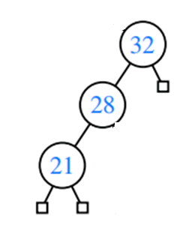
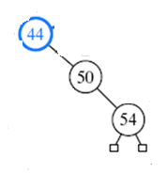
Find balance factor of every node:
Balance factor = height(right)- height(left)
If there is any unbalanced node, using rotation approaches to convert it into balanced tree

Slide 10
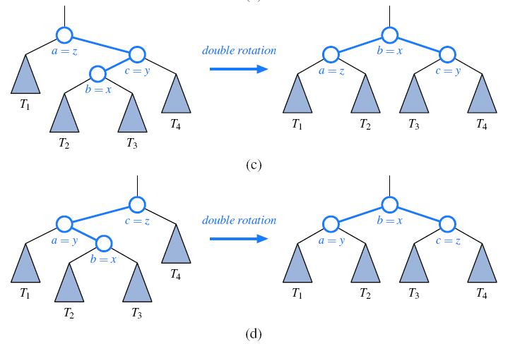
Rotations on Binary Search Tree demo - 2
Notes:
package weiss.nonstandard;
class Rotations
{
/**
* Rotate binary tree node with left child.
* For AVL trees, this is a single rotation for case 1.
*/
static BinaryNode rotateWithLeftChild( BinaryNode k2 )
{
BinaryNode k1 = k2.left;
k2.left = k1.right;
k1.right = k2;
return k1;
}
/**
* Rotate binary tree node with right child.
* For AVL trees, this is a single rotation for case 4.
*/
static BinaryNode rotateWithRightChild( BinaryNode k1 )
{
BinaryNode k2 = k1.right;
k1.right = k2.left;
k2.left = k1;
return k2;
}
/**
* Double rotate binary tree node: first left child
* with its right child; then node k3 with new left child.
* For AVL trees, this is a double rotation for case 2.
*/
static BinaryNode doubleRotateWithLeftChild( BinaryNode k3 )
{
k3.left = rotateWithRightChild( k3.left );
return rotateWithLeftChild( k3 );
}
/**
* Double rotate binary tree node: first right child
* with its left child; then node k1 with new right child.
* For AVL trees, this is a double rotation for case 3.
*/
static BinaryNode doubleRotateWithRightChild( BinaryNode k1 )
{
k1.right = rotateWithLeftChild( k1.right );
return rotateWithRightChild( k1 );
}
}
10

Slide 11
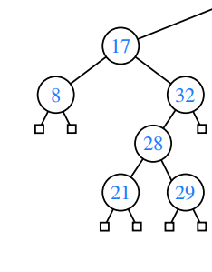
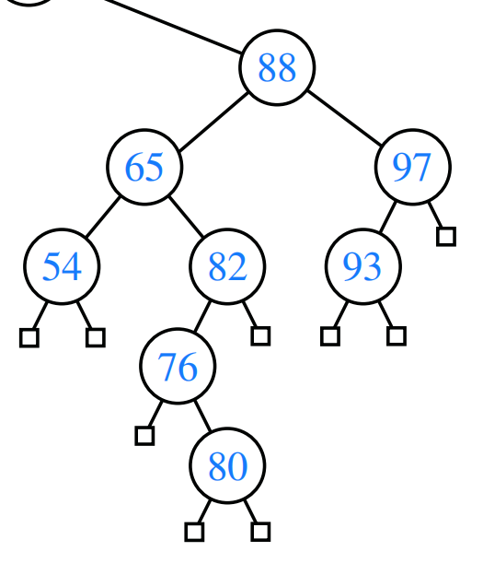
Find balance factor of every node
If there is any unbalanced node, using rotation approaches to convert it into balanced tree

Slide 12
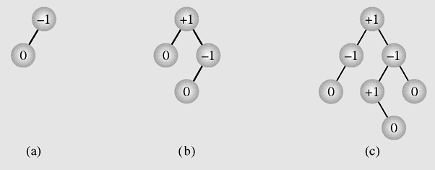
AVL Trees
An AVL tree (by Adelson Velskii, Landis) is a height-balanced binary search tree.
Examples of AVL trees
Balance factor = height(right)- height(left)
Notes:
Admissible tree
12

Slide 13
Insertion algorithm in an AVL Tree
Insert a node as in a binary search tree.
Recalculate balance factor of nodes from the inserted node back to the root.
If there is no unbalanced node (which means that no balance factors -2 or 2) in the tree then stop.
If we found the first node p whose balance factor is 2 or -2 then we should rotate p about his son. If p's and his son's balance factors have the same sign, then only single rotation should be done. If the signs of p and q are different then double rotation should be done: at first q is rotated, and then p.
Rotation rule: for left unbalane the right rotation should be used and vice versa.
It can be proved that for insertion, at most one rotation (single or double) should be done. That is because the height of the node to be rotated after rotation is exactly the same as its' height before inserting a new key, thus the heights of all ancestors of p are unchanged.
Notes:
13

Slide 14
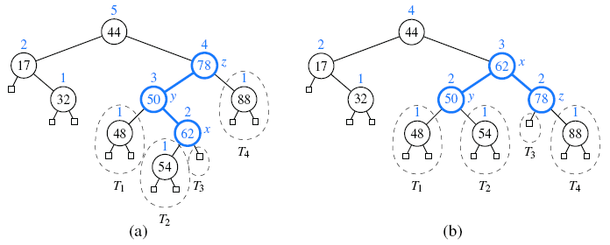
Insertion in an AVL Tree demo
Balancing a tree after insertion the key 54

Slide 15
Deletion algorithm in an AVL Tree
Delete a node as in a binary search tree.
Recalculate balance factor of nodes from the deleted node back to the root.
If there is no unbalanced node (which means that no balance factors -2 or 2) in the tree then stop.
If we found the first node p whose balance factor is 2 or -2 then we should rotate p about his son. If p's and his son's balance factors have the same sign, then only single rotation should be done. If the signs of p and q are different then double rotation should be done: at first q is rotated, and then p.
Rotation rule: for left unbalane the right rotation should be used and vice versa.
It can be proved that not the same as the case of insertion, in deletion the height of the rotated node p may be shorter by 1, thus it may causes the heights of p's ancestors shorter. Thus we should continue to balance until the height of rotated node is unchanged, and sometimes we do this to the root.
Notes:
15

Slide 16
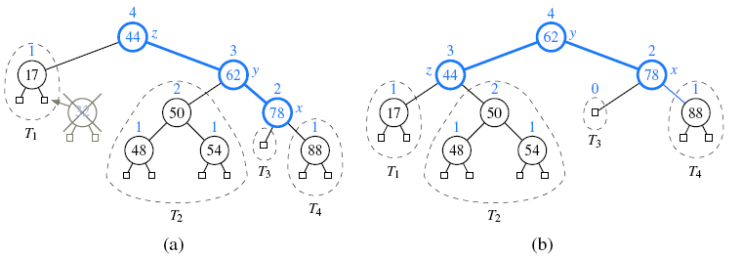
Deletion in an AVL Tree demo
Rebalancing an AVL tree after deleting the key 32

Slide 17
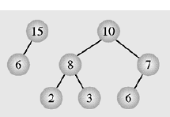
Heaps - 1
A particular kind of binary tree, called a heap, has two properties:
The value of each node is greater than or equal to the values stored in each of its children
The tree is nearly complete, i.e. it is perfectly balanced, and the leaves in the last level are all in the leftmost positions
17
These two properties define a max heap
If “greater” in the first property is replaced with “less,” then the definition specifies a min heap
Heap is used as Priority Queue and for heap-sorting

Slide 18
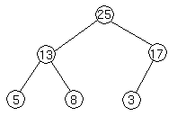
Heaps - 2
We can represent heap by array in level order, going from left to right. The array corresponding to the heap above is [25, 13, 17, 5, 8, 3].
PARENT (i) return floor((i-1)/2) LEFT (i) return 2i+1 RIGHT (i) return 2(i + 1)
The root of the tree A[0] and given index i of a node, the indices of its parent, left child and right child can be computed:

Slide 19
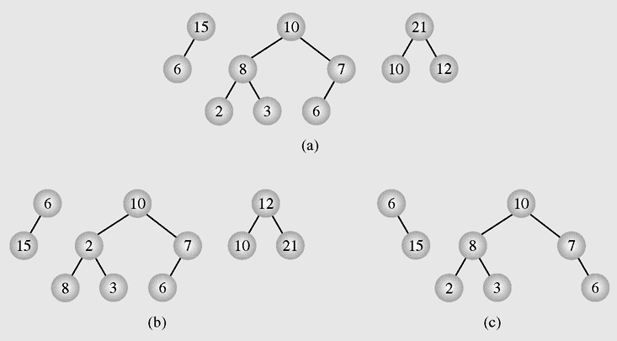
Heaps - 3
Examples of (a) heaps and (b–c) non-heaps

Slide 20
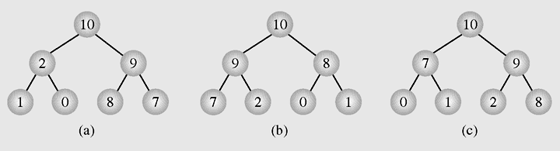
Heaps - 4
Different heaps constructed with the same elements

Slide 21
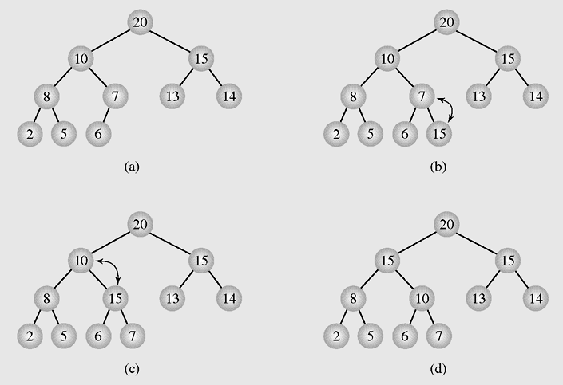
Heaps as Priority Queues - 1
Enqueuing an element to a heap

Slide 22
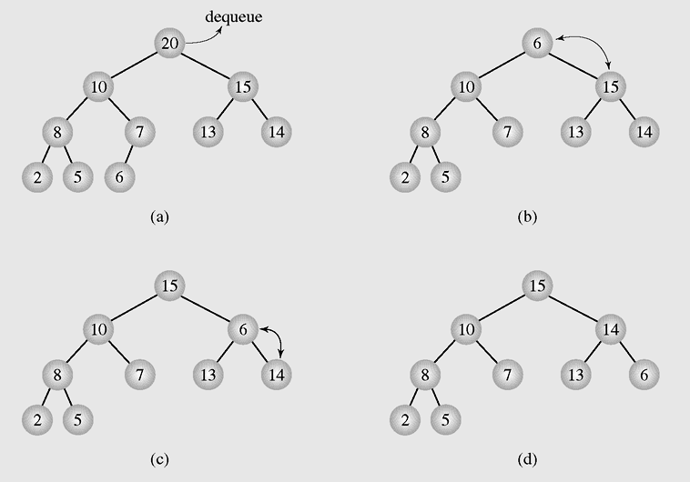
Heaps as Priority Queues - 2
Dequeuing an element from a heap

Slide 23
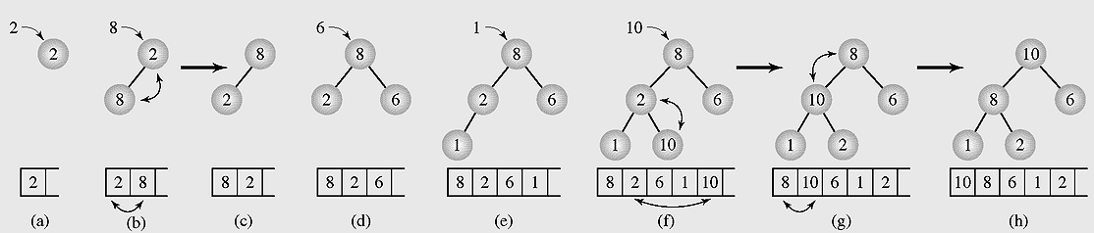
Organizing Arrays as Heaps - 1
Organizing an array as a heap with a top-down method
PARENT (i) return floor((i-1)/2) LEFT (i) return 2i+1 RIGHT (i) return 2(i + 1)

Slide 24
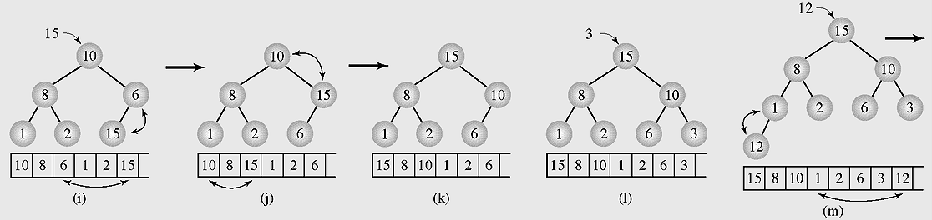
Organizing Arrays as Heaps - 2
Organizing an array as a heap with a top-down method (continued)
PARENT (i) return floor((i-1)/2) LEFT (i) return 2i+1 RIGHT (i) return 2(i + 1)

Slide 25
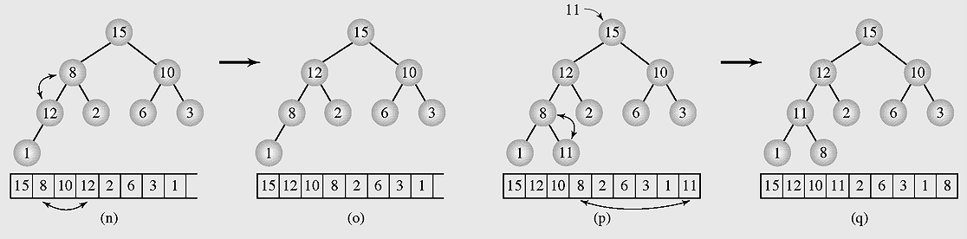
Organizing Arrays as Heaps - 3
Organizing an array as a heap with a top-down method (continued)
PARENT (i) return floor((i-1)/2) LEFT (i) return 2i+1 RIGHT (i) return 2(i + 1)

Slide 26
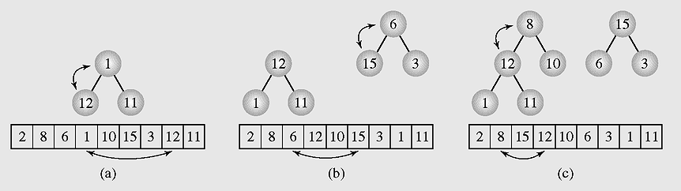
Organizing Arrays as Heaps - 4
Transforming the array [2 8 6 1 10 15 3 12 11] into a heap with a bottom-up method
PARENT (i) return floor((i-1)/2) LEFT (i) return 2i+1 RIGHT (i) return 2(i + 1)

Slide 27
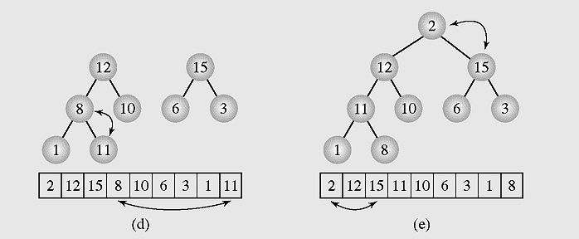
Organizing Arrays as Heaps - 5
Transforming the array [2 8 6 1 10 15 3 12 11] into a heap with a bottom-up method (continued)
PARENT (i) return floor((i-1)/2) LEFT (i) return 2i+1 RIGHT (i) return 2(i + 1)

Slide 28
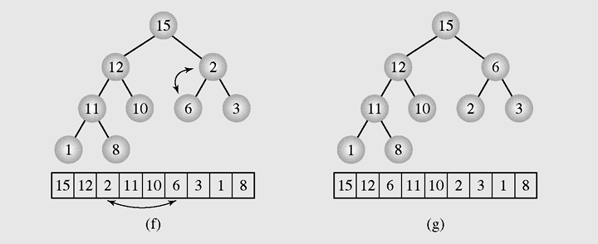
Organizing Arrays as Heaps - 6
Transforming the array [2 8 6 1 10 15 3 12 11] into a heap with a bottom-up method (continued)
PARENT (i) return floor((i-1)/2) LEFT (i) return 2i+1 RIGHT (i) return 2(i + 1)

Slide 29
Organizing Arrays as Heaps - 7
//Transform the array to HEAP
int i,s,f;int x;
for(i=1;i<n;i++)
{ x=a[i]; s=i; //s is a son, f=(s-1)/2 is father
while(s>0 && x>a[(s-1)/2])
{ a[s]=a[(s-1)/2]; s=(s-1)/2; };
a[s]=x;
}
}

Slide 30
Organizing Arrays as Heaps - 8
// Transform heap to sorted array
for(i=n-1;i>0;i--)
{ x=a[i];a[i]=a[0];
f=0; //f is father
s=2*f+1; //s is a left son
// if the right son is larger then it is selected
if(s+1<i && a[s]<a[s+1]) s=s+1;
while(s<i && x<a[s])
{ a[f]=a[s]; f=s; s=2*f+1;
if(s+1<i && a[s]<a[s+1]) s=s+1;
};
a[f]=x;
};

Slide 31
Polish Notation and Expression Trees - 1
31
Polish notation is a special notation for propositional logic that eliminates all parentheses from formulas:
(5 − 6) * 7 = * − 5 6 7 (prefix notation)
The compiler rejects everything that is not essential to retrieve the proper meaning of formulas.

Slide 32
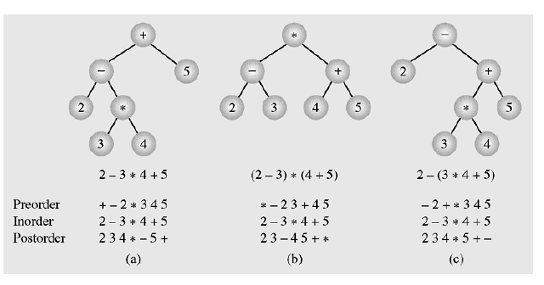
Polish Notation and Expression Trees - 2
32
Examples of three expression trees and results of their traversals

Slide 33
Exercise
To implement an AVL tree. a concept balance factor is introduced (bal = height(right) - height(left). Suppose an AVL tree is created by inserting to the tree the following keys sequentially: 5, 2, 6, 1, 3, 4. What is the balance factor of the node 2? (please note that the tree is still AVL)
What is the minimum number of nodes in a full binary tree with height 3? (In a tree the height of root is 1, and in a full binary tree every node other than the leaves has two children).
Notes:
1: -1
2: 7

Slide 34
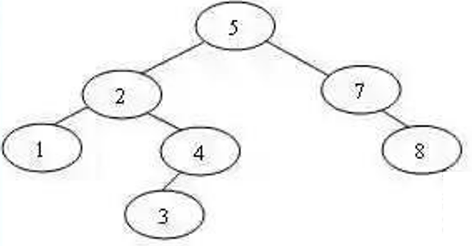
Exercise
3. Insert 9 into the following AVL tree
4. Remove 1 from the following AVL tree

Slide 35
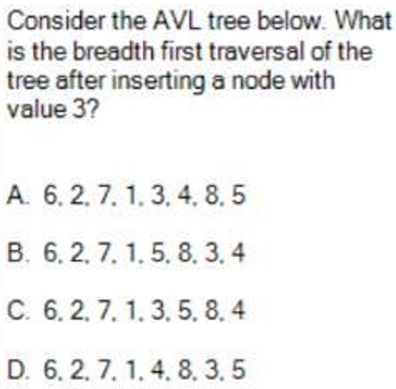
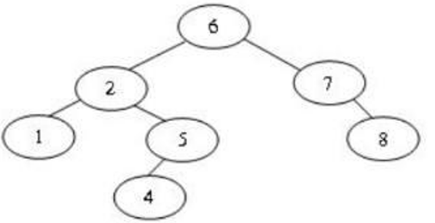
Exercise
Notes:
D

Slide 36
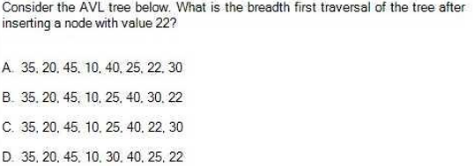
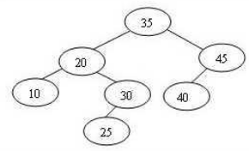
Exercise
Notes:
C

Slide 37
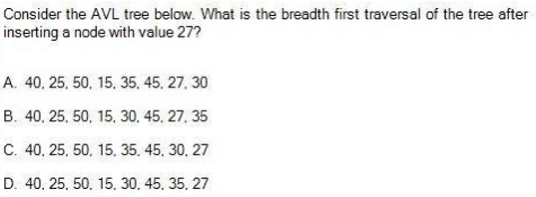
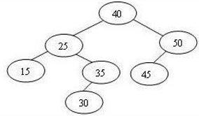
Exercise
Notes:
B

Slide 38
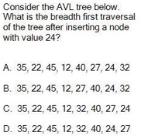
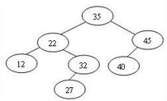
Exercise
Notes:
B

Slide 39
Summary - 1
A tree is a data type that consists of nodes and arcs.
The root is a node that has no parent; it can have only child nodes.
Each node has to be reachable from the root through a unique sequence of arcs, called a path.
An orderly tree is where all elements are stored according to some predetermined criterion of ordering.
A binary tree is a tree whose nodes have two children (possibly empty), and each child is designated as either a left child or a right child.

Slide 40
Summary
Balanced Binary Tree
Balancing a Tree - Simple Balanced Algorithm
Rotations on Binary Search Tree
AVL Tree
Insertion in an AVL Tree
Deletion in an AVL Tree
Heaps
Heaps as Priority Queue
Polish Notation and Expression Trees

Slide 41
Reading at home
Text book: Data Structures and Algorithms in Java
11.2 Balanced Search Trees - 472
11.3 AVL Trees - 479
9.3 Heaps - 370
9.3.1 The Heap Data Structure - 370
9.3.2 Implementing a Priority Queue with a Heap - 372

